Slide 1


Predicting Telcom Customer Retention Using Machine Learning
Bruno Xie

Slide 2


Introduction
Founded in 1972, with over 40 years of experience in the design and development of high-performance network communications solutions
Covers network segments: transport, connectivity, and distributed network applications
Provides services: phone, multiple lines, internet, online security, online backup, device protection, tech support, and streaming TV and movies

Slide 3
Our Goal
Retention management is extremely important as the costs of acquiring new customers are higher than keeping the existing customers
Our goal is help Telco retain customers by predicting users’ behaviors
We will run several models including logistic regression, random forest, and boosting to study which factors will impact customer churn

Slide 4
Data Overview
Source: Kaggle
Summary: 7043 Telco customers
Customer Behavior: churn
Services: phone, multiple lines, internet, online security, online backup, device protection, tech support, and streaming TV and movies
Customer Account Information: how long they’ve been a customer, contract, payment method, paperless billing, monthly charges, and total charges
Demographic Info: gender, age range, and if they have partners and dependents

Slide 5
Which type of customers are more likely to churn?
Data Exploration
Services
Multiple Lines | Yes | No | No phone service
Online Security | Yes | No | No internet service
Online Backup | Yes | No | No internet service
Device Protection | Yes | No | No internet service
Tech Support | Yes | No | No internet service
Streaming TV | Yes | No | No internet service
Streaming Movie | Yes | No | No internet service
Services
Internet Service | DSL | Fiber optic |  | No
Phone Service | Yes |  | No

Slide 6
Data Exploration
Which type of customers are more likely to churn?
Customer Account Information
Contract | Month-to-month |  | One year |  | Two years
Paperless Billing | Yes |  |  | No
Payment Method | Eletronic check | Mailed check |  | Bank transfer |  | Credit card
Monthly Charges | High |  |  | Low
Total Charges | High |  |  | Low
Tenure | Long |  |  | Short
Demographic Info
Gender | Female | Male
Senior Citizen | Yes | No
Partner | Yes | No
Dependents | Yes | No

Slide 7
Data Cleaning
Dropped irrelevant variable customer ID
Standardized continuous variables monthly charges, total charges, tenure
Transformed categorical variables into separated variables with dummy values
Split 50% data into training set, 25% into validation set, 25% into test set

Slide 8
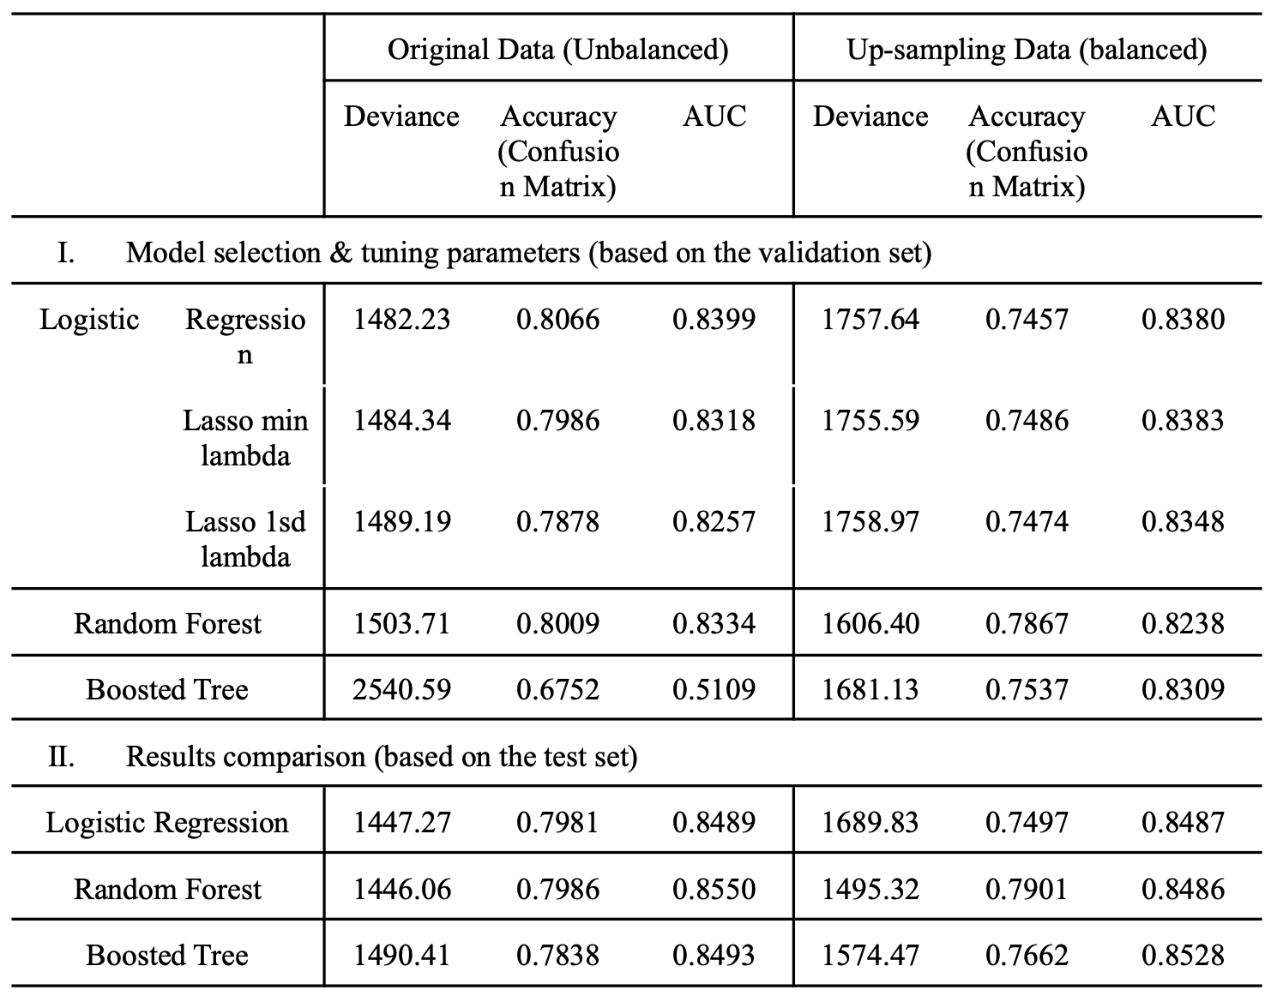
Summary of Results

Slide 9
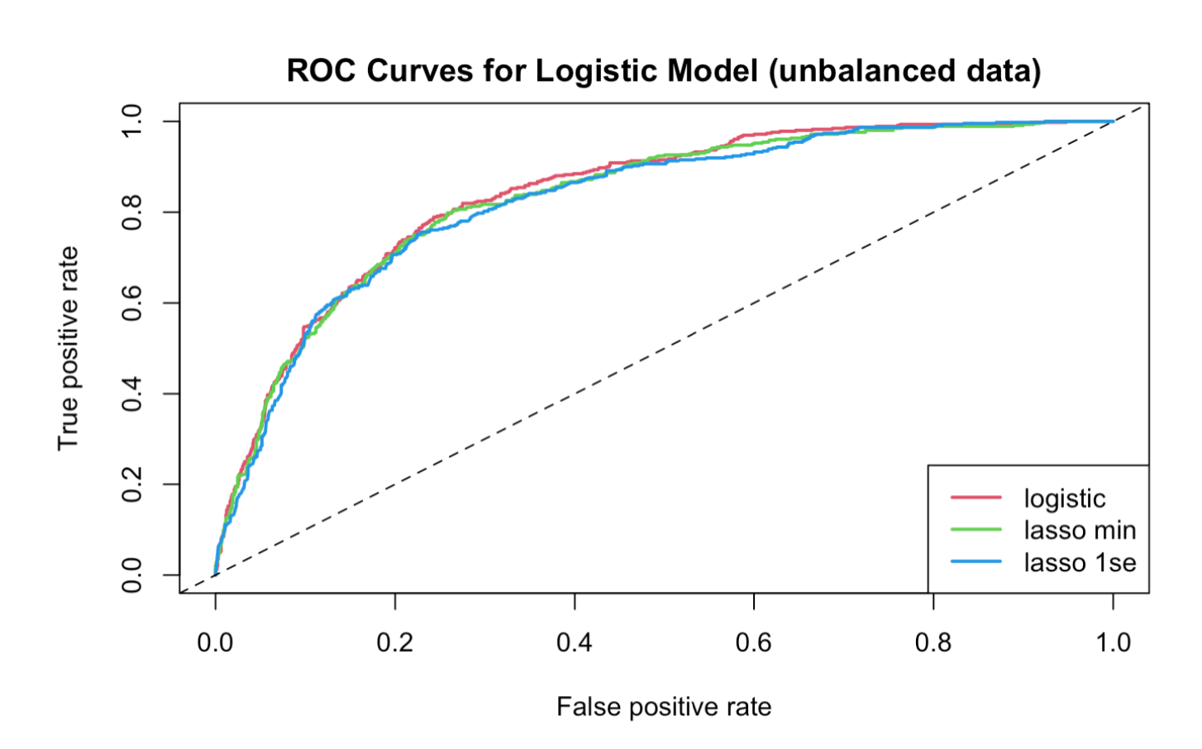
Logistic Regression – Unbalanced Data
Regular logistic regression
Lasso model with λ that minimizes cross-validated error
Lasso model with λ in which the error is within 1 se of the minimum
similar predictive powers in terms of deviance, accuracy, and AUC

Slide 10
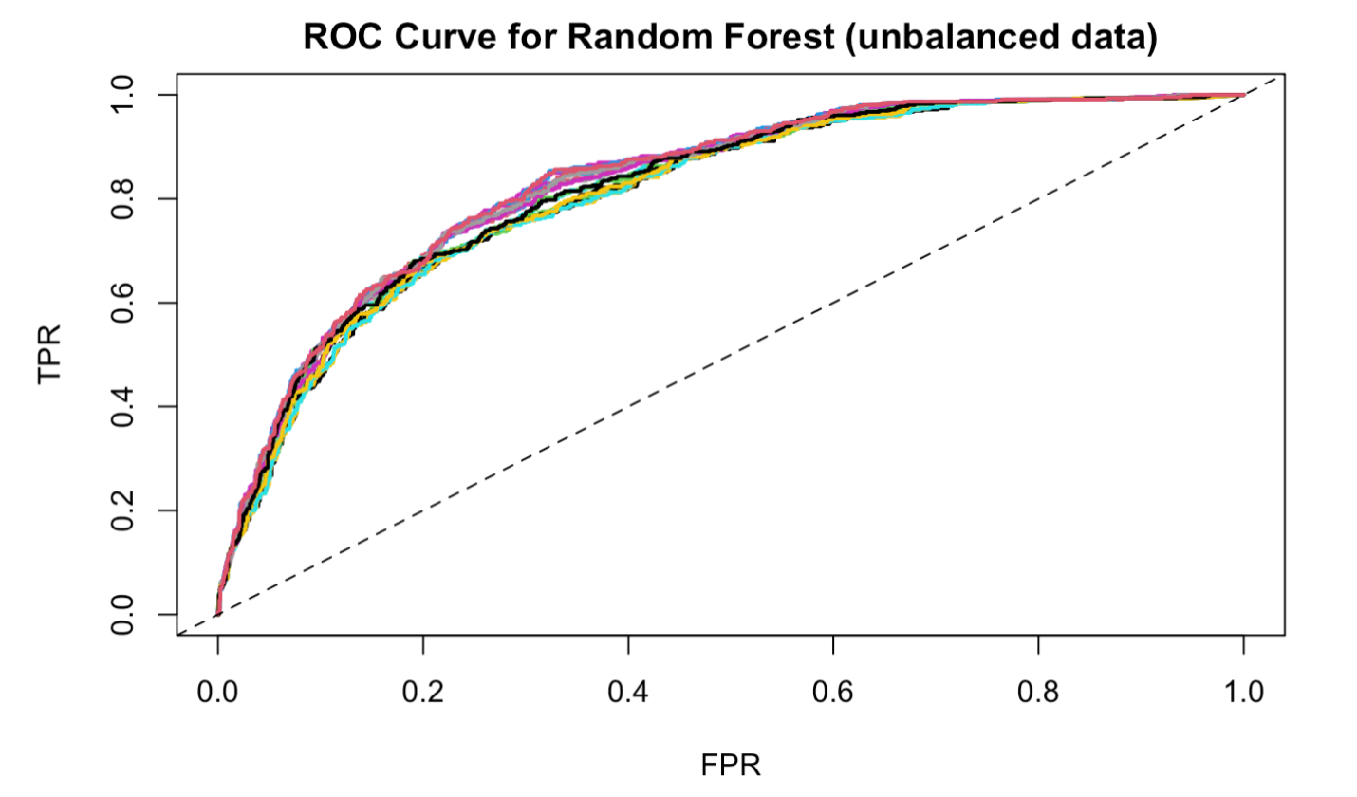
Random Forest – Unbalanced Data
Parameter search:
number of trees
number of variables to possibly split at in each node
minimal node size to tune the parameters
Optimal parameters:
number of trees = 1000
number of variables to split = 5
minimal node size = 5

Slide 11
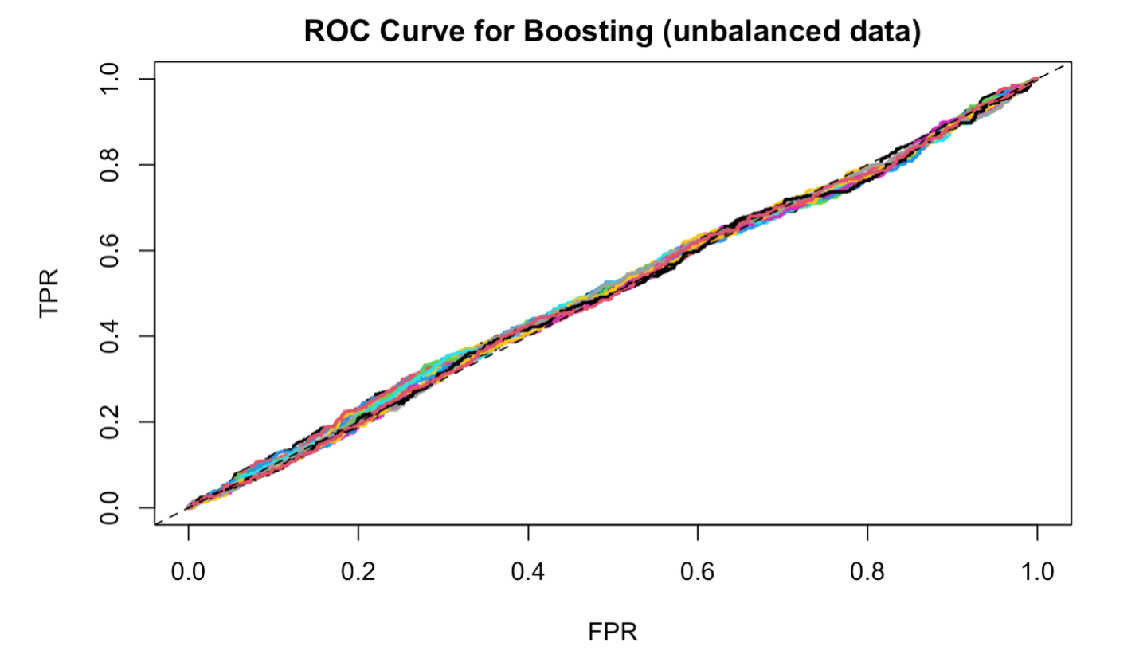
Boosting – Unbalanced Data
Parameter search:
learning rate
maximum depth of trees
Optimal parameters:
learning rate = 0.01
maximum depth of trees = 1

Slide 12
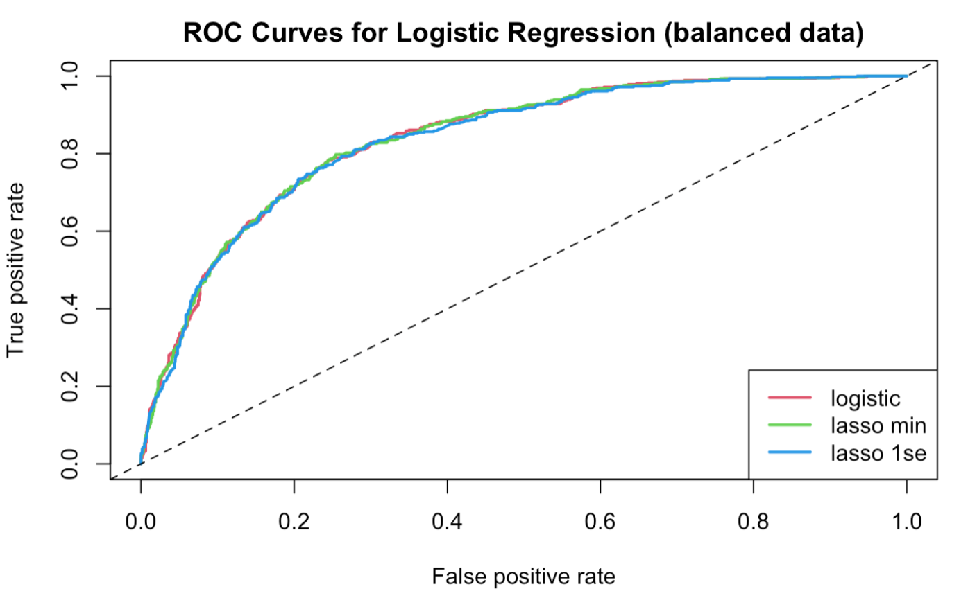
Logistic Regression – Balanced Data
Regular logistic regression
Lasso model with λ that minimizes cross-validated error
Lasso model with λ in which the error is within 1 se of the minimum
similar predictive powers in terms of deviance, accuracy, and AUC
Compared to unbalanced data, the performance is worse off

Slide 13
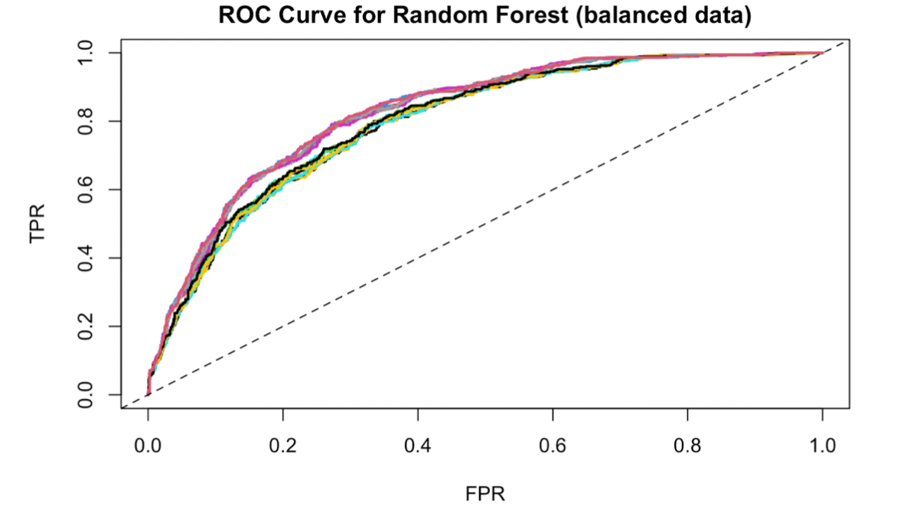
Random Forest – Balanced Data
Parameter search:
number of trees
number of variables to possibly split at in each node
minimal node size to tune the parameters
Optimal parameters:
number of trees = 1000
number of variables to split = 5
minimal node size = 20

Slide 14
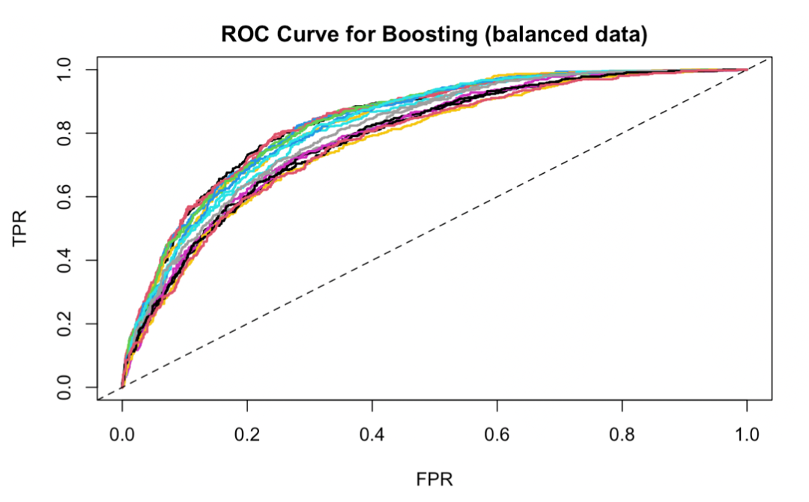
Boosting – Balanced Data
Parameter search:
learning rate
maximum depth of trees
Optimal parameters:
learning rate = 0.3
maximum depth of trees = 5
Compared to unbalanced data, the performance of boosting trees improves substantially

Slide 15
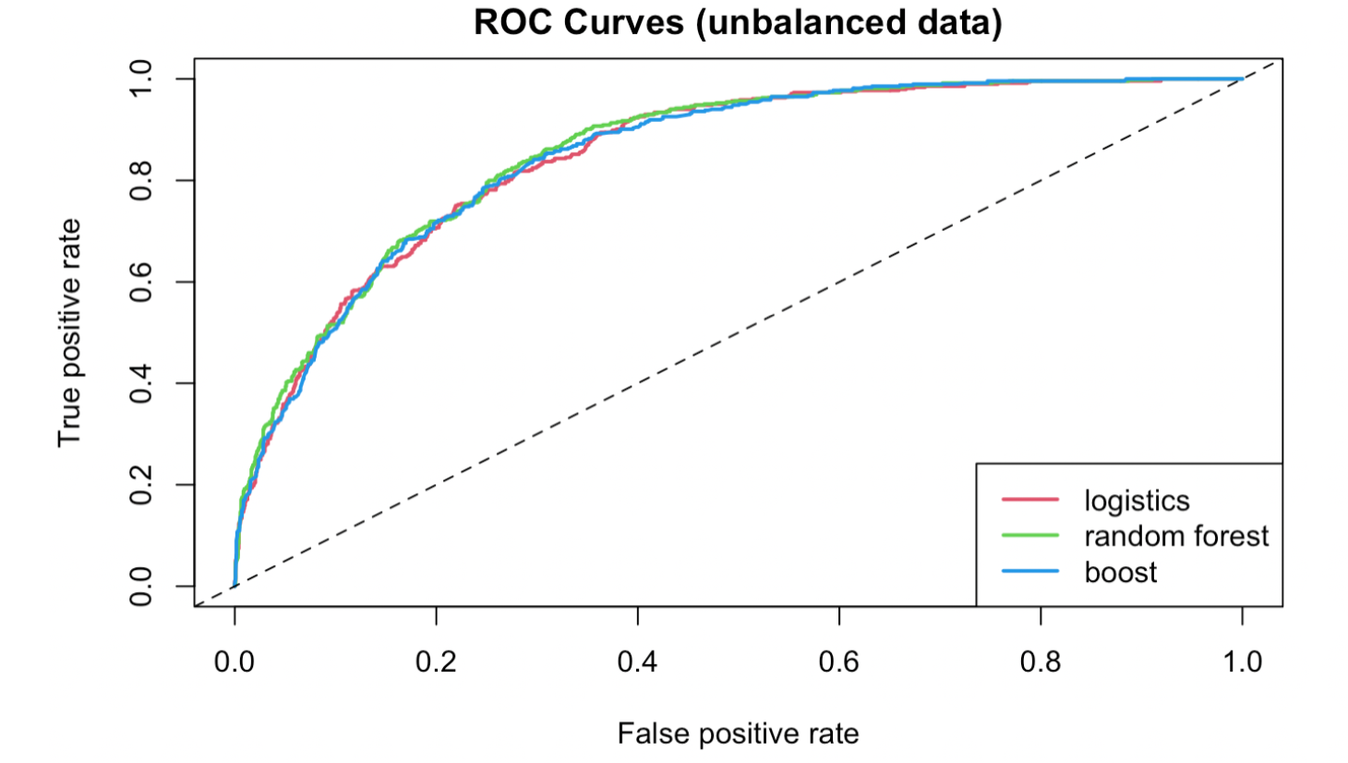
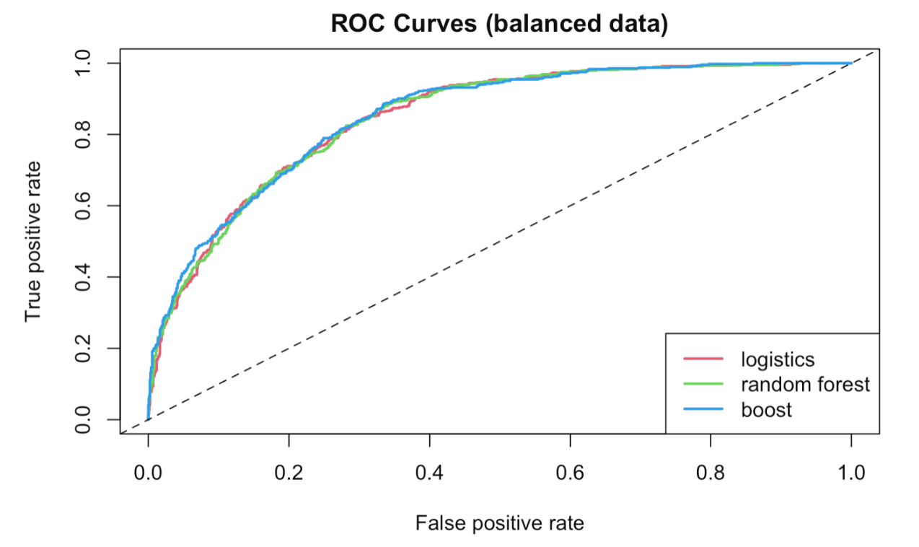
Results – Unbalanced & Balanced Data
Random Forest is optimal for both

Slide 16
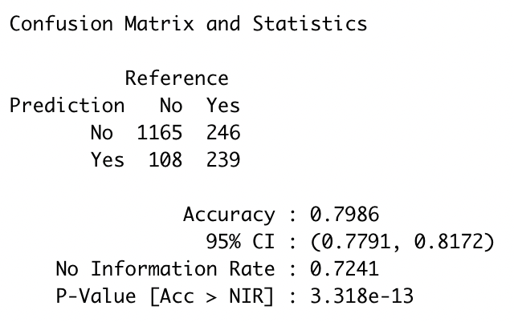
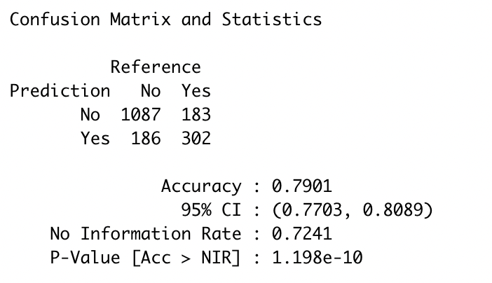
Results – Unbalanced & Balanced Data
Random Forest is optimal for both
A potential problem is, while the model is doing generally well in predicting users who stay, it doesn’t predict well in users who churn

Slide 17
Conclusions and Improvements
Best-performing model: random forest
80% accuracy overall
Issue faced: unbalanced dataset
Using up-sampling but not successfully solving the issue
Future improvement: focusing on better dealing with class imbalance

